Slide 1
Mapping Carleton’s Network Topology
Analyzing how Carleton is connected to the rest of the internet

Slide 2
Why this Matters
Company
Traceroutes reveals the path data takes through numerous networks to reach its destination.
It also reveals how long this process takes, and what wide area networks are involved.
We can observe where data spends the most time in regional and intercontinental travel.
We can also learn what WANs and ISPs are involved in forwarding and handing off the data.

Slide 3
Methodology
Company
Used RIPE probes, and tracert and ping command to reach the following locations
Lahore University of Management Sciences, Lahore, Pakistan
London School of Economics, London, England
University of Queensland, Brisbane, Queensland, Australia
University of California, Santa Cruz, California, United States
University of São Paulo, São Paulo, Brazil
Microsoft Corporation, United States

Slide 4
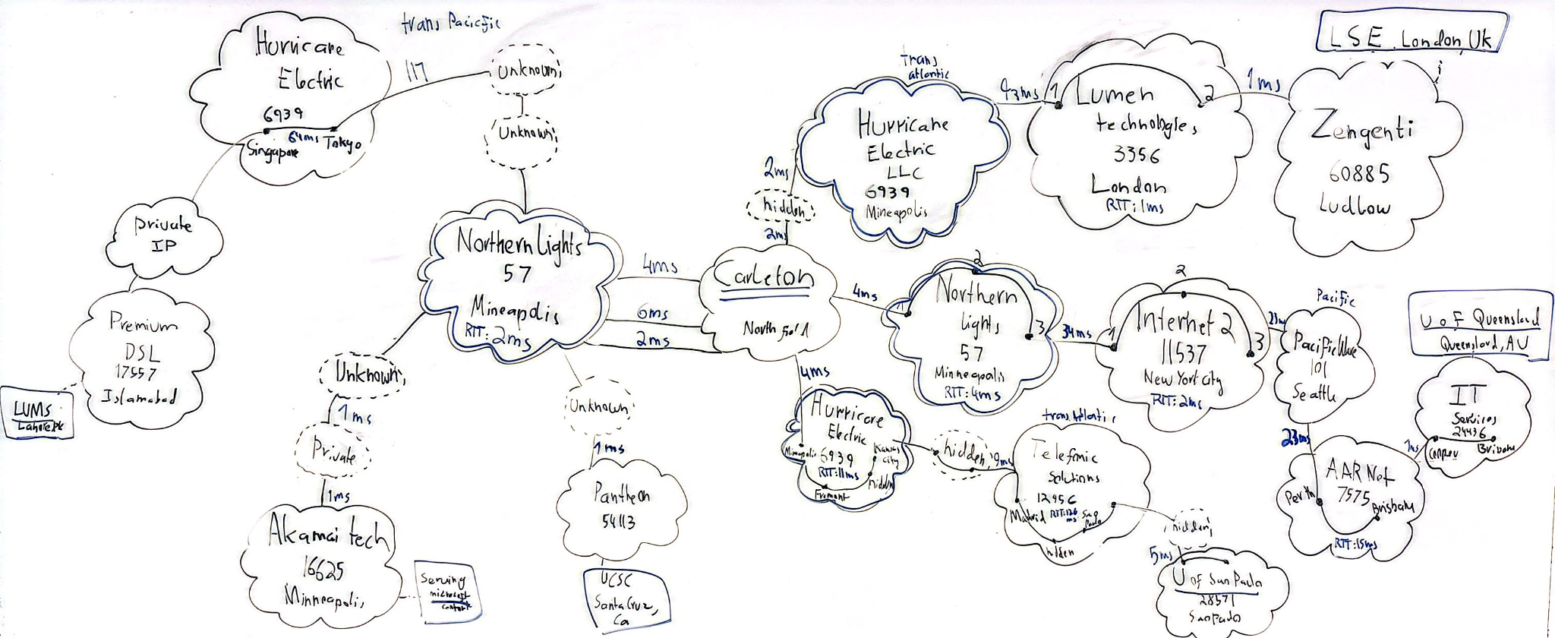
The Topology
Notes:
Most time spent: HE on the routes to LUMS (Pakistan), and University of Queensland (Australia). Also on Telefonic Solutions. This makes sense since intercontinental. Also reveals they are poorly connected.
Connection: Carleton is directly connected to Northern Lights (Minnesota area) and Hurricane electric (Tier 2), as all traceroutes went through them.
Northern lights handles regional transfer, and HE handles intercontinental.
Connectedness: America is the best connected (<10 ms), Europe is strong (about 150 ms), Asia is weak (about 250 ms), Oceania is moderate (about 220 ms), and South America is strong (about 150 ms)
More tier 1 providers, connections stay local, don't have to route through lot of places.
Overseas connections:
HE from tokyo to singapore to lahore
Pacifica wave from seattle to perth australia
HE from kansas city to madrid, then Telefonic from Madrid to Sao Paulo
HE from Minneapolis to London
About 2 private IPs for each route, except for Australia and England.

Slide 5
Observations
Company
Most time spent:
  HE on the routes to Pakistan, and Australia
  Telefonic Solutions to Brazil
  Reveals they are poorly connected
Connection: Carleton is directly connected to Northern Lights (Minnesota area) and Hurricane electric (Tier 1), as all traceroutes went through them.
  HE provides intercontinental transfer
  NL provides regional transfer
Notes:
The most time being spent on HE and Telefonic makes sense since they provide intercontinental connectivity. The reliance on these also reveals how Pakistan, Brazil and Australia are not that well connected since these were the only major providers involved.
Overall, Northern lights handles regional transfer, and HE handles intercontinental.

Slide 6
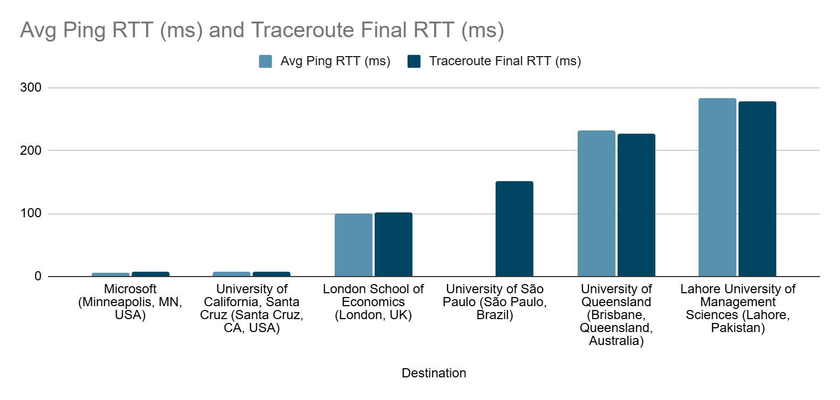
Ping and Traceroute
Notes:
In terms of connectedness, America is the best connected (<10 ms)
Europe is strong (about 150 ms)
South America is strong (about 150 ms)
Oceania is moderate (about 220 ms)
Asia is weak (about 250 ms)

Slide 7
Route Trip Times and Pings
Destination | Avg Ping RTT (ms) | Min / Max RTT (ms) | Traceroute Final RTT (ms)
Microsoft (Minneapolis, MN, USA) | 6 | 6/7 | 7
University of California, Santa Cruz (Santa Cruz, CA, USA) | 7 | 6/14 | 7
London School of Economics (London, UK) | 100 | 100/101 | 101
University of São Paulo (São Paulo, Brazil) | No Response | 151/152 | 152
University of Queensland (Brisbane, Queensland, Australia) | 232 | 226/228 | 227
Lahore University of Management Sciences (Lahore, Pakistan) | 284 | 271/278 | 278
Company
Notes:
RTT makes sense as it approximately corresponds to distance: destinations further away, such as Asia, took way longer than regional ones.

Slide 8
RIPE Times
Destination | Google (ms) | Wikipedia (ms) | Facebook (ms) | Average (ms)
University of California, Santa Cruz (Santa Cruz, CA, USA) | 8 | 10 | 5 | 8
London School of Economics (London, UK) | 12 | 12 | 23 | 15
Microsoft / Akamai Edge (Minneapolis, MN, USA) | 48 | 27 | 5 | 27
University of São Paulo (São Paulo, Brazil) | 111 | 130 | 109 | 116
Lahore University of Management Sciences (Lahore, Pakistan) | 326 | 99 | 32 | 152
University of Queensland (Brisbane, Queensland, Australia) | 165 | 202 | 180 | 182
Company

Slide 9
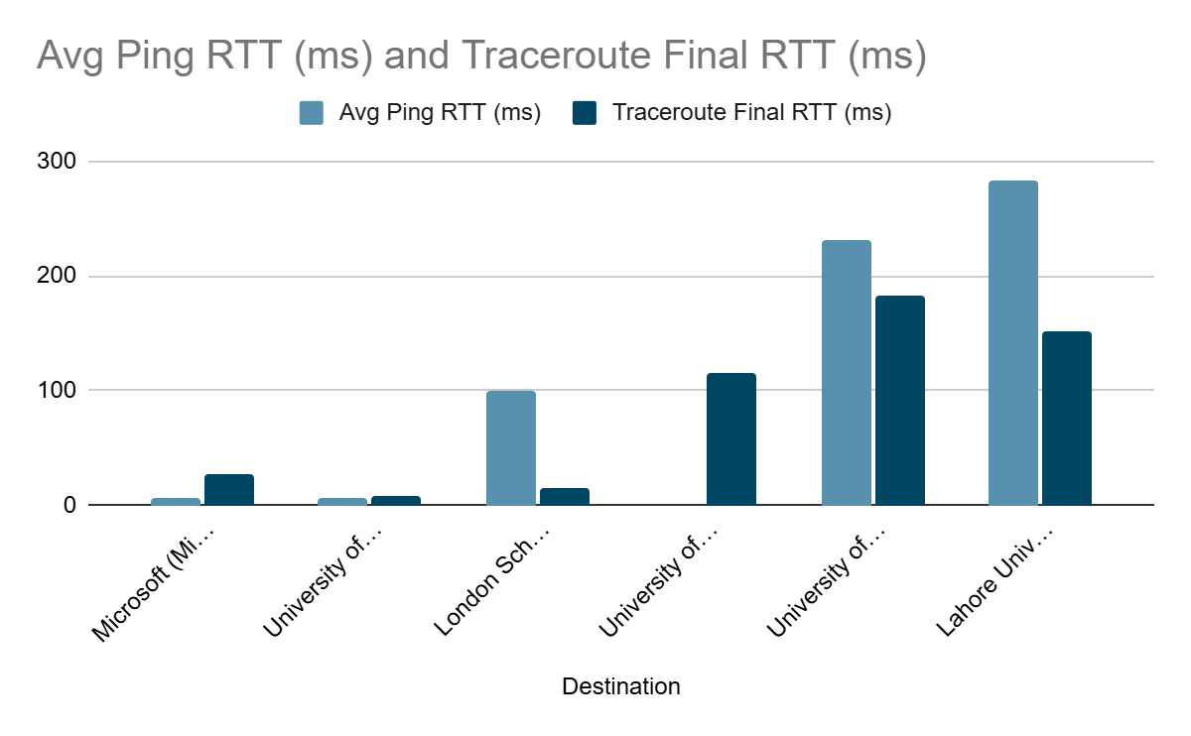
Comparison
Notes:
Since RIPE measures local connectivity, the times are much lower
Traceroutes go from Carleton to London, whereas RIPE just goes from London to, for example, Google, which likely has a local server.
Times for RIPE and ping within the US are similar, since local connectivity is strong.
Intercontinental travel adds a lot of latency.
Traceroutes show true latency end-to-end
RIPE shows latency for local internet services

Slide 10
Explanation
Company
RIPE measures local connectivity, the times are much lower
Traceroutes go from Carleton to London, whereas RIPE just goes from London to, for example, Google, which likely has a local server.
Traceroutes show true latency end-to-end
RIPE shows latency for local internet services

Slide 11
Drawbacks and Conclusion
Company
Numerous request timed outs.
Private IPs (10.x.x.x)
ICMPs are lowest priority so blocked
Only get traces from responsive routers.
Overall, HE is the backbone of connections (especially intercontinental)
Latency also degrades internationally, and RIPE is not completely representative.

